Slide 1
Vue3 上手新体验
卢创旭
- 中台材料域-前端 -

Slide 2
css 处理器发展
part 1
时长约10分钟

Slide 3
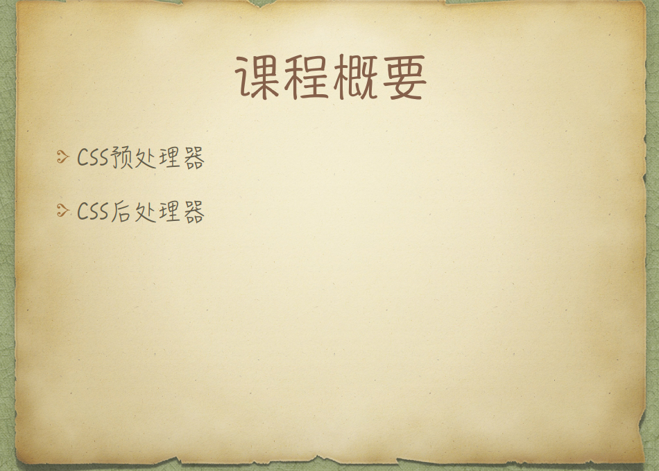
https://mp.weixin.qq.com/s/Zqw8f5jX6MmeURRzc44C6Q

Slide 4
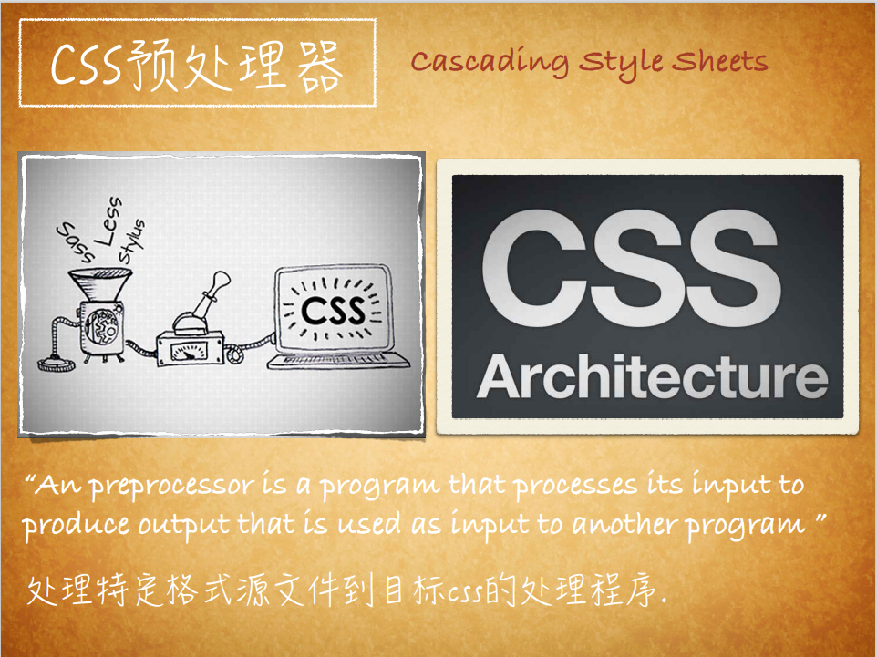

Slide 5
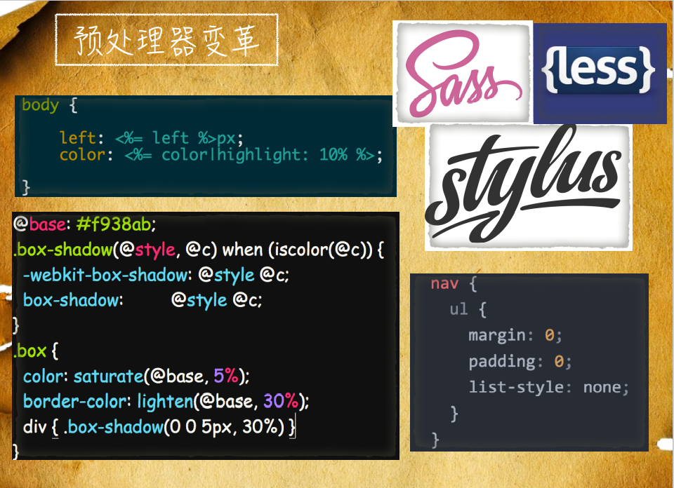

Slide 6
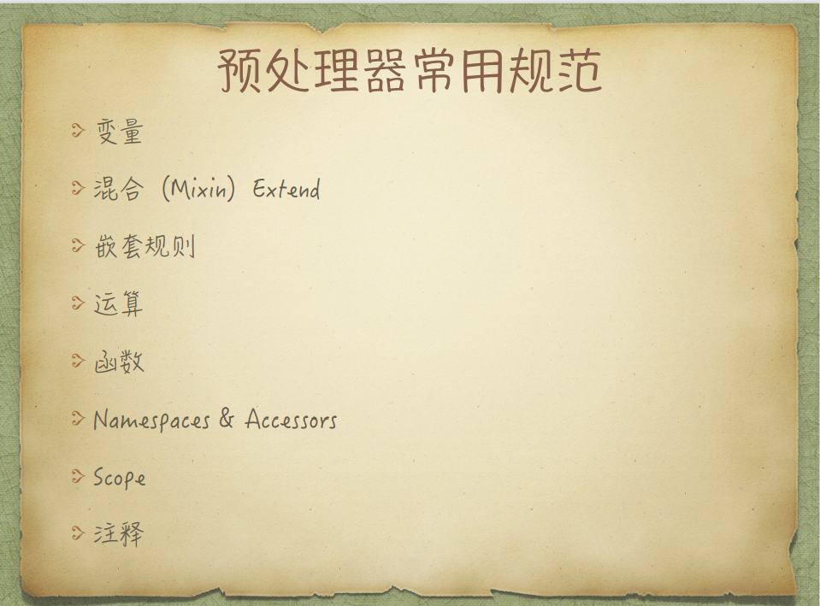

Slide 7
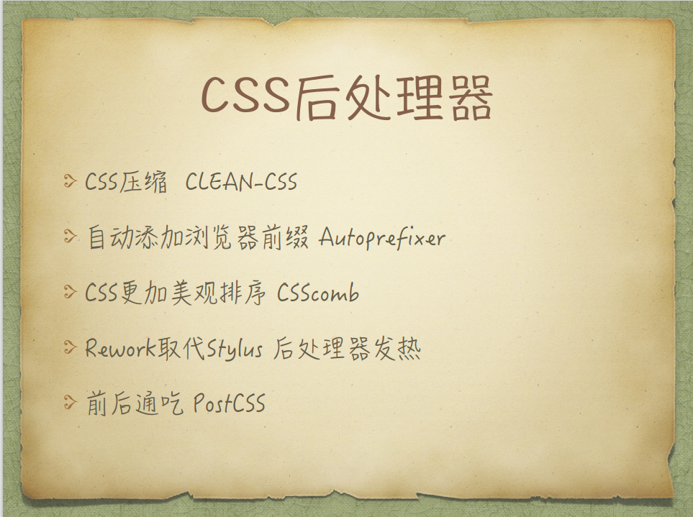

Slide 8
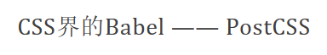
https://github.com/csstools/postcss-preset-env/blob/main/src/lib/plugins-by-id.js#L36

Slide 9
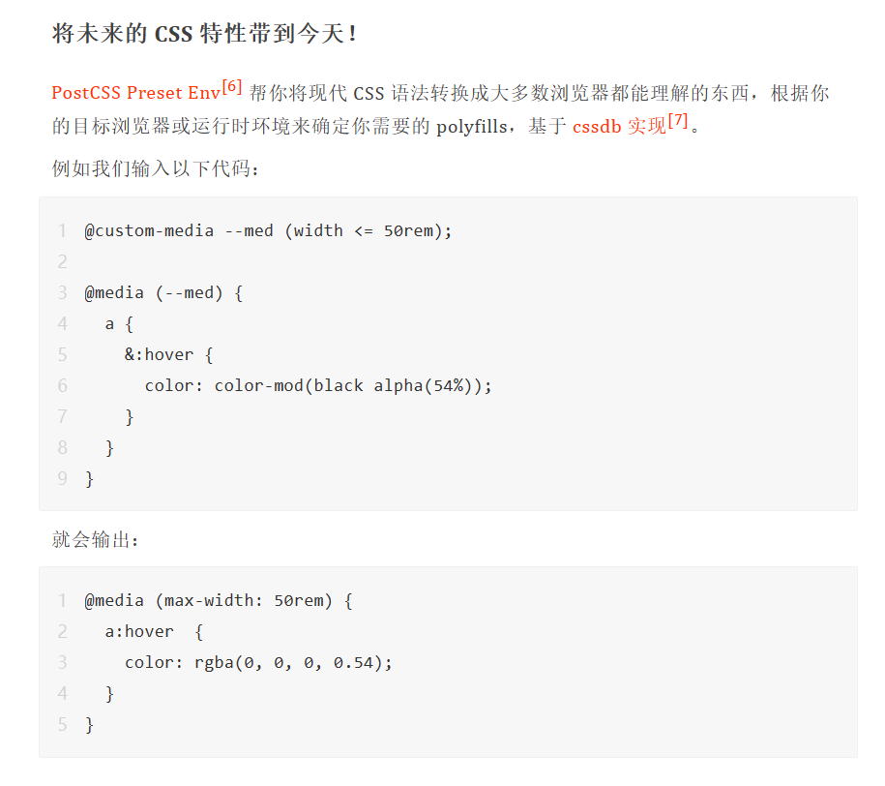

Slide 10
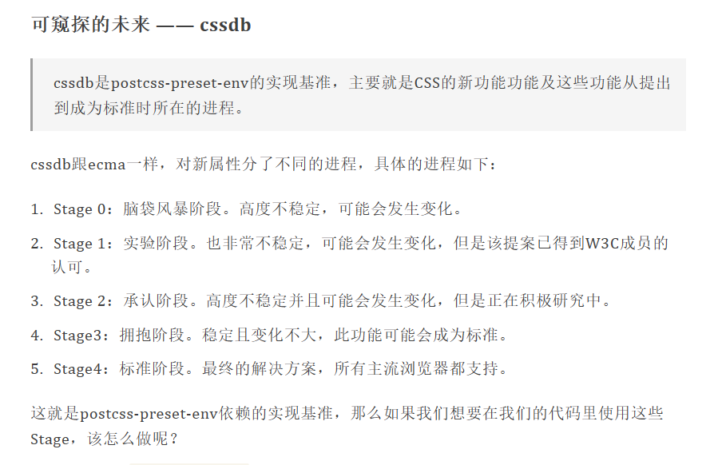

Slide 11
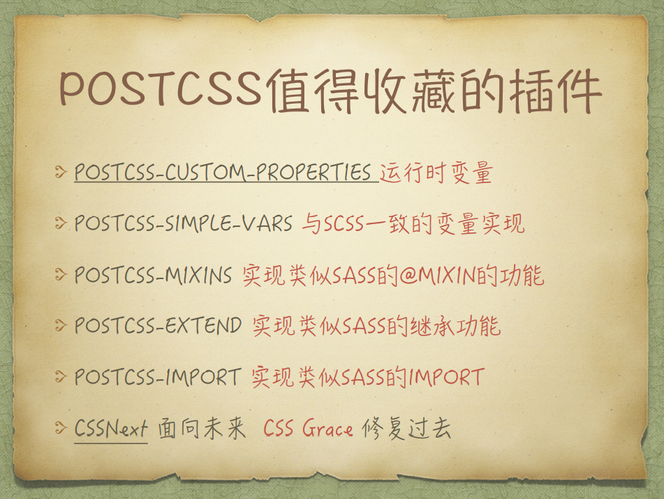

Slide 12
css 魔术师 hudini
part 2
时长约20分钟

Slide 13


Slide 14
https://github.com/GoogleChromeLabs/houdini-samples/blob/master/paint-worklet/spinners/roller-painter.js

Slide 15
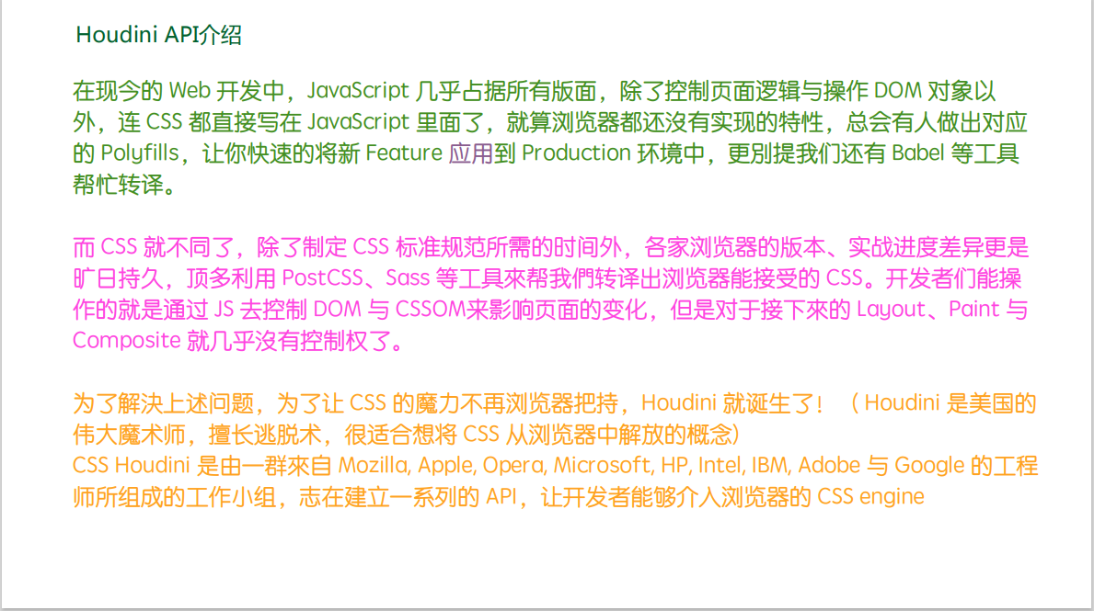

Slide 16
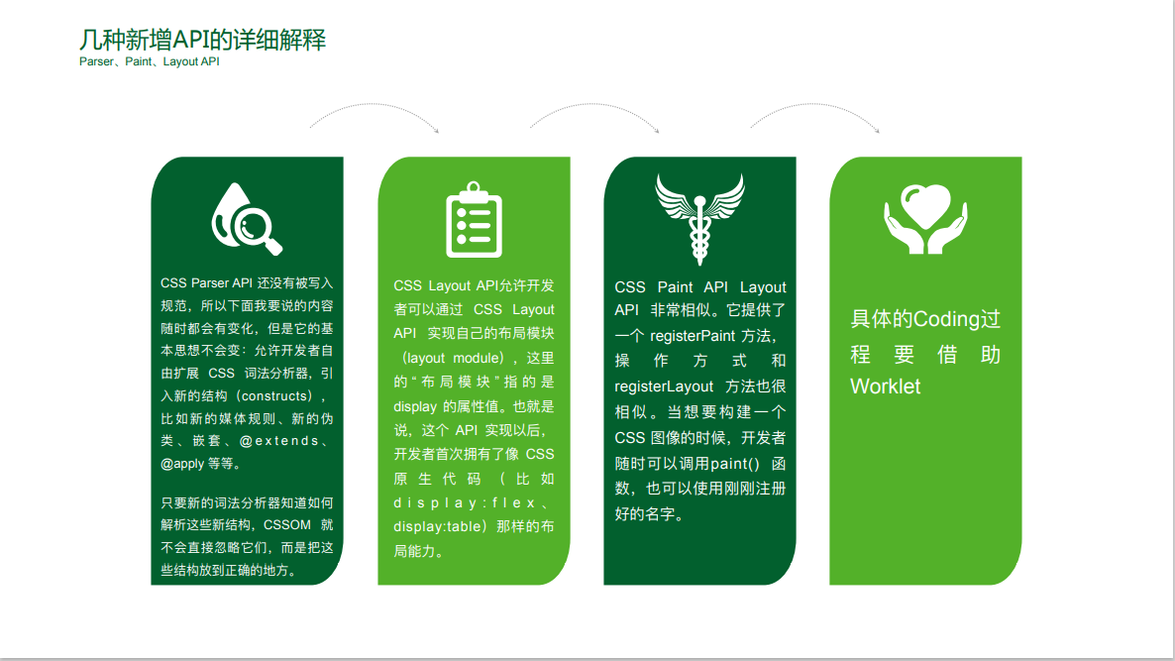

Slide 17
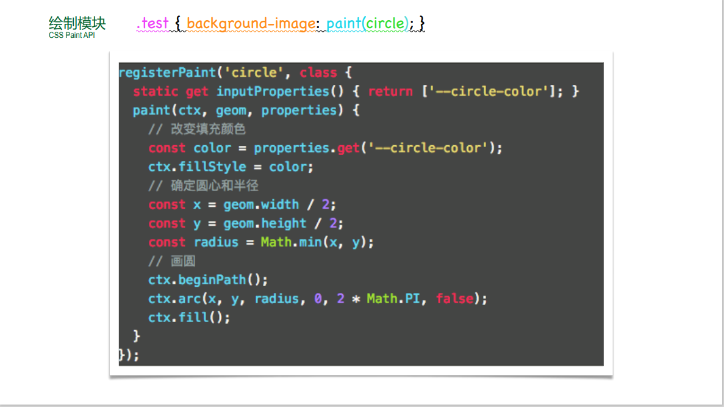

Slide 18
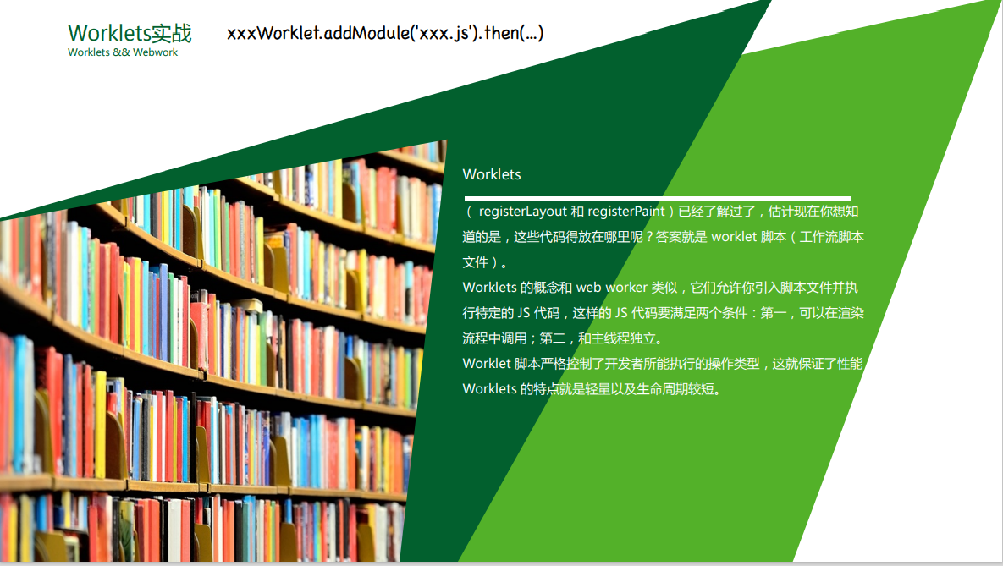

Slide 19


Slide 20
https://v.qq.com/x/page/o0631vkbm7v.html
https://ishoudinireadyyet.com
https://mp.weixin.qq.com/s/Zqw8f5jX6MmeURRzc44C6Q

Slide 21
Thank you!

